Slide 1
Concepts Of Classes and Objects
Objects:
An object is an instance of a class. A class is a template or blueprint from which objects are created. So, an object is the instance(result) of a class.
An object has three characteristics:
State: represents the data (value) of an object.
Behavior: represents the behavior (functionality) of an object such as deposit, withdraw, etc.
Identity: An object identity is typically implemented via a unique ID. The value of the ID is not visible to the external user. However, it is used internally by the JVM to Identify each object uniquely.
Object Definitions:
An object is a real-world entity.
An object is a runtime entity.
The object is an entity which has state and behavior.
The object is an instance of a class.

Slide 2
Class
A class in Java can contain:
Fields
Methods
Constructors
Blocks
Nested class and interface
Syntax to declare a class:
class <class_name>
{
field; //properties
methods;
}

Slide 3
Object and Class Example: main within the class
class Student
{
//defining fields
int id; //field or data member or instance variable
String name;
//creating main method inside the Student class
public static void main(String args[])
{
//Creating an object or instance
Student s1=new Student();//creating an object of Student
//Printing values of the object
System.out.println(s1.id); //accessing member through reference variable
System.out.println(s1.name);
}
}

Slide 4
//Java Program to demonstrate having the main method in another class
//Creating Student class.
class Student{
int id;
String name;
}
//Creating another class TestStudent1 which contains the main method
class TestStudent1{
public static void main(String args[]){
Student s1=new Student();
System.out.println(s1.id);
System.out.println(s1.name);
}
}

Slide 5
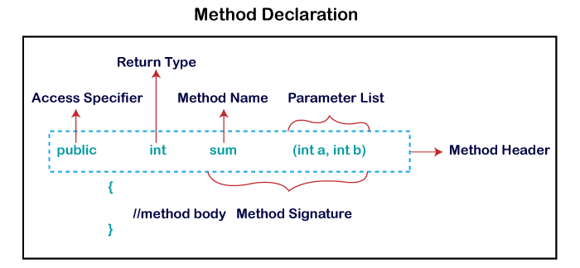
Introduction to methods
collection of instructions that performs a specific task.
It provides the reusability of code.

Slide 6
Types of Method
Predefined Method
User-defined Method
Predefined Method:
public class Demo
{
public static void main(String[] args)
{
// using the max() method of Math class
System.out.print("The maximum number is: " + Math.max(9,7));
}
}

Slide 7
User-defined Method:
//user defined method
public static void findEvenOdd(int num)
{
//method body
if(num%2==0)
System.out.println(num+" is even");
else
System.out.println(num+" is odd");
}

Slide 8
How to Call or Invoke a User-defined Method
import java.util.Scanner;
public class EvenOdd
{
public static void main (String args[])
{
//creating Scanner class object
Scanner scan=new Scanner(System.in);
System.out.print("Enter the number: ");
//reading value from the user
int num=scan.nextInt();
//method calling
findEvenOdd(num);
}
}

Slide 9
public class Addition
{
public static void main(String[] args)
{
int a = 19;
int b = 5;
int c = add(a, b); //a and b are actual parameters
System.out.println("The sum of a and b is= " + c);
}
public static int add(int n1, int n2) //n1 and n2 are formal parameters (Instance Method)
{
int s;
s=n1+n2;
return s; //returning the sum
}
}

Slide 10
Static Method
public class Display
{
public static void main(String[] args)
{
show();
}
static void show()
{
System.out.println("It is an example of static method.");
}
}

Slide 11
Abstract Method
The method that does not has method body is known as abstract method.
It always declares in the abstract class.
To create an abstract method, we use the keyword abstract.
Syntax
abstract void method_name();

Slide 12
abstract class Demo //abstract class
{
abstract void display(); //abstract method declaration
}
public class MyClass extends Demo
{
void display() //method implementation
{
System.out.println("Abstract method?");
}
public static void main(String args[])
{
Demo obj = new MyClass(); //creating object of abstract class
obj.display(); //invoking abstract method
}
}

Slide 13
Method over loading
Class has multiple methods having same name but different in parameters, it is known as Method Overloading.
Different ways to overload the method
By changing number of arguments
By changing the data type

Slide 14
Method Overloading: changing no. of arguments
class Adder{
static int add(int a,int b)
{
return a+b;
}
static int add(int a,int b,int c)
{
return a+b+c;
}
}
class TestOverloading1{
public static void main(String[] args){
System.out.println(Adder.add(11,11));
System.out.println(Adder.add(11,11,11));
}
}

Slide 15
Method Overloading: changing data type of arguments
class Adder{
static int add(int a, int b)
{
return a+b;
}
static double add(double a, double b)
{
return a+b;
}
}
class TestOverloading2{
public static void main(String[] args){
System.out.println(Adder.add(11,11));
System.out.println(Adder.add(12.3,12.6));
}}

Slide 16
Constructors in Java
a constructor is a block of codes similar to the method. It is called when an instance of the class is created. At the time of calling constructor, memory for the object is allocated in the memory.
Rules for creating Java constructor:
Constructor name must be the same as its class name
A Constructor must have no explicit return type
A Java constructor cannot be abstract, static, final, and synchronized

Slide 17
Types of Java constructors:
Default constructor (no-arguments constructor)
Parameterized constructor
Default constructor:
class Bike1{
Bike1() //creating a default constructor
{
System.out.println("Bike is created");
}
public static void main(String args[]) //main method
{
Bike1 b=new Bike1(); //calling a default constructor
}
}

Slide 18
Parameterized Constructor
class Student4 {
int id;
String name;
Student4(int i,String n) //creating a parameterized constructor
{
id = i;
name = n;
}
void display()
{
System.out.println(id+" "+name);
}
public static void main(String args[]){
Student4 s1 = new Student4(111,"Karan"); //creating objects and passing values
Student4 s2 = new Student4(222,"Aryan");
s1.display(); //calling method to display the values of object
s2.display();
}
}

Slide 19
Constructor overloading
class Student5{
int id;
String name;
int age;
Student5(int i,String n) { //creating two arg constructor
id = i;
name = n;
}
Student5(int i,String n,int a) { //creating three arg constructor
id = i;
name = n;
age=a;
}
void display() { System.out.println(id+" "+name+" "+age); }
public static void main(String args[]){
Student5 s1 = new Student5(111,"Karan");
Student5 s2 = new Student5(222,"Aryan",25);
s1.display();
s2.display();
}
}

Slide 20
Difference between constructor and method in Java
Java Constructor | Java Method
A constructor is used to initialize the state of an object. | A method is used to expose the behavior of an object.
A constructor must not have a return type. | A method must have a return type.
The constructor is invoked implicitly. | The method is invoked explicitly.
The Java compiler provides a default constructor if you don't have any constructor in a class. | The method is not provided by the compiler in any case.
The constructor name must be same as the class name. | The method name may or may not be same as the class name.

Slide 21
Java static keyword
The static keyword in Java is used for memory management mainly. We can apply static keyword with variables, methods, blocks and nested classes.
The static can be:
Variable (also known as a class variable)
Method (also known as a class method)
Block

Slide 22
Java static variable
If you declare any variable as static, it is known as a static variable.
The static variable can be used to refer to the common property of all objects (which is not unique for each object).
Example: the company name of employees, college name of students, etc.
The static variable gets memory only once in the class area at the time of class loading.
Advantages of static variable
It makes your program memory efficient (i.e., it saves memory).

Slide 23
class Student{
int rollno;//instance variable
String name;
static String college ="ITS";//static variable
//constructor
Student(int r, String n){
rollno = r;
name = n;
}
void display (){System.out.println(rollno+" "+name+" "+college);} //method to display the values
}
public class TestStaticVariable1{ //Test class to show the values of objects
public static void main(String args[]){
Student s1 = new Student(111,"Karan");
Student s2 = new Student(222,"Aryan");
//we can change the college of all objects by the single line of code
//Student.college="BBDIT";
s1.display();
s2.display();
}
}

Slide 24
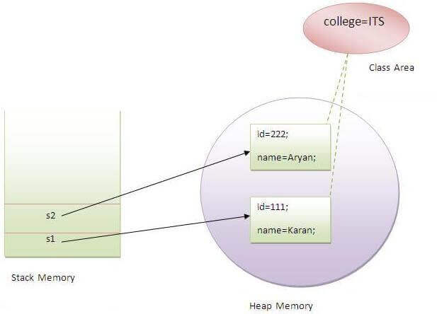
Output: 111 Karan ITS
222 Aryan ITS

Slide 25
static method
A static method can be invoked without the need for creating an instance of a class.
class Calculate{
static int cube(int x)
{
return x*x*x;
}
public static void main(String args[]){
int result=Calculate.cube(5);
System.out.println(result);
}
}

Slide 26
Restrictions for the static method:
The static method can not use non static data member or call non-static method directly.
this and super cannot be used in static context.
class A{
int a=40;//non static
public static void main(String args[]){
System.out.println(a);
}
}
Output:Compile Time Error

Slide 27
Q) Why is the Java main method static?
Ans) It is because the object is not required to call a static method. If it were a non-static method, JVM creates an object first then call main() method that will lead the problem of extra memory allocation.
static block
Is used to initialize the static data member.
It is executed before the main method at the time of classloading.

Slide 28
class A2{
static
{
System.out.println("static block is invoked");
}
public static void main(String args[])
{
System.out.println("Hello main");
}
}
Output: static block is invoked
Hello main

Slide 29
Access control (or) Access Modifiers in Java
The access modifiers in Java specifies the accessibility or scope of a field, method, constructor, or class.
We can change the access level of fields, constructors, methods, and class by applying the access modifier on it.
Access Modifier | within class | within package | outside package by subclass only | outside package
Private | Y | N | N | N
Default | Y | Y | N | N
Protected | Y | Y | Y | N
Public | Y | Y | Y | Y

Slide 30
Four types of Java access modifiers:
Private: The access level of a private modifier is only within the class. It cannot be accessed from outside the class.
Default: The access level of a default modifier is only within the package. It cannot be accessed from outside the package. If you do not specify any access level, it will be the default.
Protected: The access level of a protected modifier is within the package and outside the package through child class. If you do not make the child class, it cannot be accessed from outside the package.
Public: The access level of a public modifier is everywhere. It can be accessed from within the class, outside the class, within the package and outside the package.

Slide 31
private
class A{
private int data=40;
private void msg()
{
System.out.println("Hello java");
}
}
public class Simple{
public static void main(String args[]){
A obj=new A();
System.out.println(obj.data); //Compile Time Error
obj.msg(); //Compile Time Error
}
}

Slide 32
class A{
private A(){} //private constructor
void msg()
{
System.out.println("Hello java");}
}
public class Simple{
public static void main(String args[])
{
A obj=new A(); //Compile Time Error
}
}

Slide 33
Default
In this example, we have created two packages pack and mypack. We are accessing the A class from outside its package, since A class is not public, so it cannot be accessed from outside the package.
In the below example, the scope of class A and its method msg() is default so it cannot be accessed from outside the package.

Slide 34
//save by A.java
package pack;
class A
{
void msg(){System.out.println("Hello");}
}
---------------------------------------------------------------------------
//save by B.java
package mypack;
import pack.*;
class B{
public static void main(String args[]){
A obj = new A();//Compile Time Error
obj.msg();//Compile Time Error
}
}

Slide 35
Protected
//save by A.java
package pack;
public class A{
protected void msg(){System.out.println("Hello");}
}
-----------------------------------------------------------------------------------------------
//save by B.java
package mypack;
import pack.*;
class B extends A{
public static void main(String args[]){
B obj = new B();
obj.msg();
}
}
Output:Hello

Slide 36
In this example, we have created the two packages pack and mypack.
The A class of pack package is public, so can be accessed from outside the package. But msg method of this package is declared as protected, so it can be accessed from outside the class only through inheritance.

Slide 37
Public
//save by A.java
package pack;
public class A{
public void msg(){System.out.println("Hello");}
}
---------------------------------------------------------------------
//save by B.java
package mypack;
import pack.*;
class B{
public static void main(String args[]){
A obj = new A();
obj.msg();
}
}
Output:Hello

Slide 38
Java Garbage Collection
Garbage Collection is process of reclaiming the runtime unused memory automatically. In other words, it is a way to destroy the unused objects.
To do so, we were using free() function in C language and delete() in C++. But, in java it is performed automatically. So, java provides better memory management.
Advantage of Garbage Collection:
It makes java memory efficient because garbage collector removes the unreferenced objects from heap memory.
It is automatically done by the garbage collector(a part of JVM) so we don't need to make extra efforts.

Slide 39
How can an object be unreferenced:
By nulling the reference
By assigning a reference to another
By anonymous object etc.
1) By nulling a reference:
Employee e=new Employee();
e=null;
2) By assigning a reference to another:
Employee e1=new Employee();
Employee e2=new Employee();
e1=e2;//now the first object referred by e1 is available for garbage collection

Slide 40
3) By anonymous object:
new Employee();
finalize() method
The finalize() method is invoked each time before the object is garbage collected. This method can be used to perform clean-up processing. This method is defined in Object class as:
protected void finalize(){}

Slide 41
gc() method
The gc() method is used to invoke the garbage collector to perform clean-up processing. The gc() is found in System and Runtime classes.
public class TestGarbage1{
public void finalize(){System.out.println("object is garbage collected");}
public static void main(String args[]){
TestGarbage1 s1=new TestGarbage1();
TestGarbage1 s2=new TestGarbage1();
s1=null;
s2=null;
System.gc();
}
}
OUTPUT: object is garbage collected
object is garbage collected

Slide 42
Java String
char[] ch={‘V’,‘i',‘g',‘n',‘a',‘n'};
String s=new String(ch);
(OR)
String s="javatpoint";
java.lang.String ---- Package

Slide 43
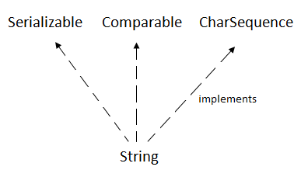
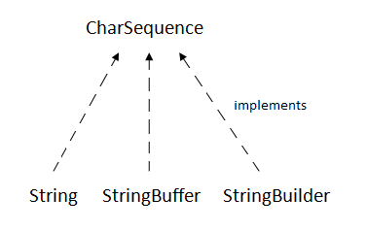

Slide 44
Java String Example
public class StringExample{
public static void main(String args[]){
String s1="java"; //creating string by Java string literal
char ch[]={'s','t','r','i','n','g','s'};
String s2=new String(ch);//converting char array to string
String s3=new String("example");//creating Java string by new keyword
System.out.println(s1);
System.out.println(s2);
System.out.println(s3);
}}

